Slide 1
Machine Learning
@Data Science

Slide 2
Definition 1: “Learning is any process by which a system improves performance from experience.”
Definition 2: “Machine Learning is concerned with computer programs that automatically improve their performance through experience. “
Definition 3: The concept of learning in a ML system
Learning = Improving with experience at some task
– Improve over task T,
– With respect to performance measure, P
– Based on experience, E.

Slide 3
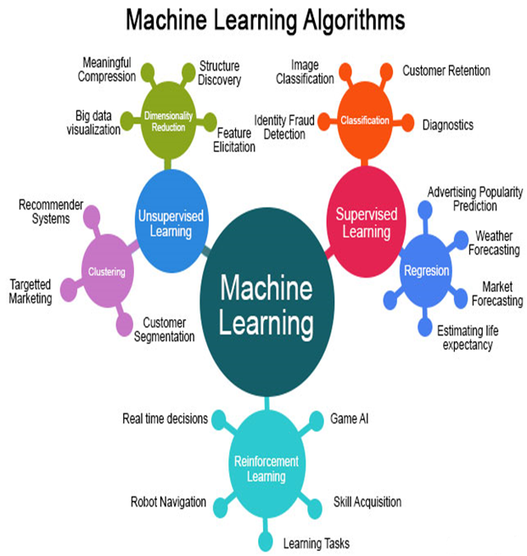

Slide 4
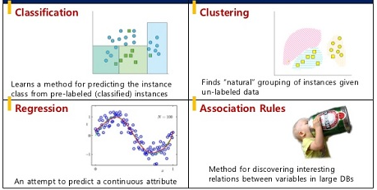

Slide 5
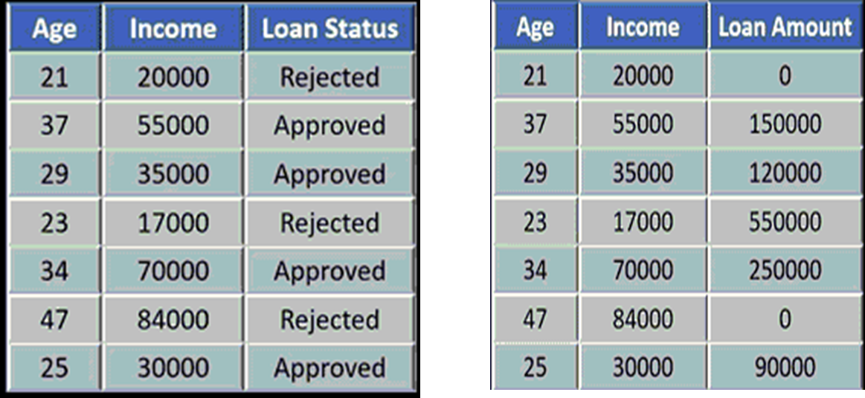
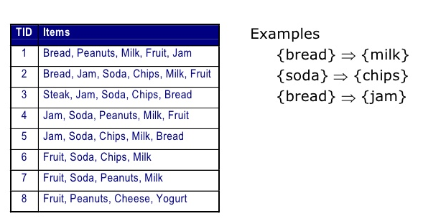
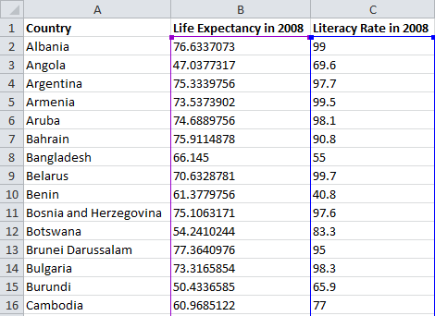

Slide 6
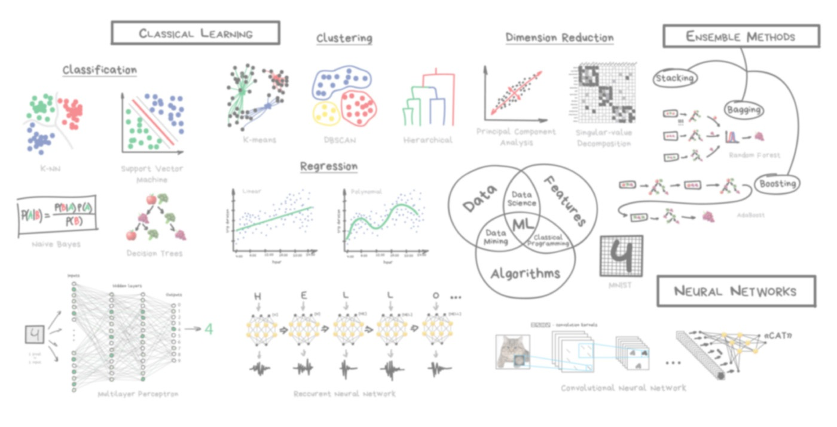

Slide 7
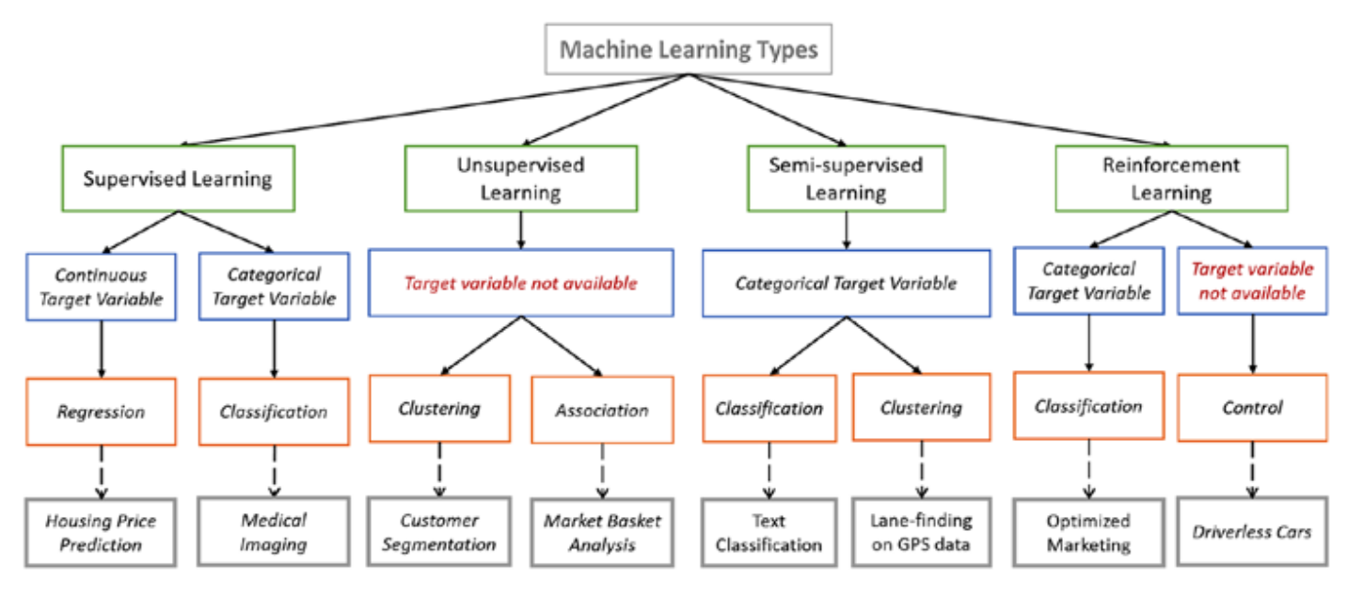

Slide 8
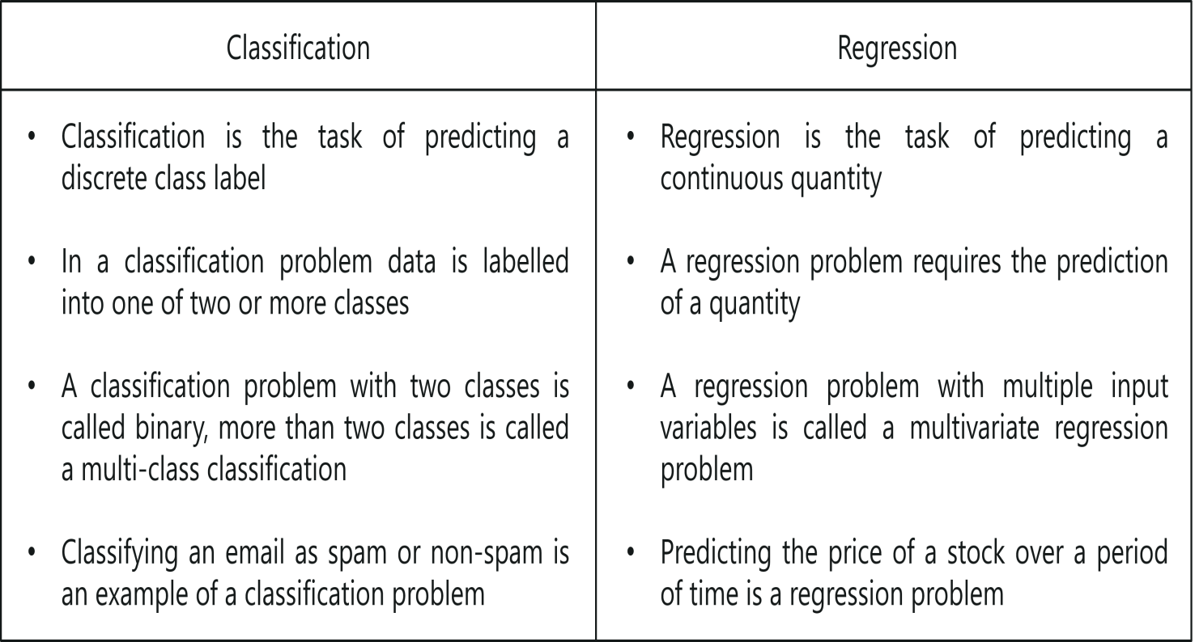

Slide 9
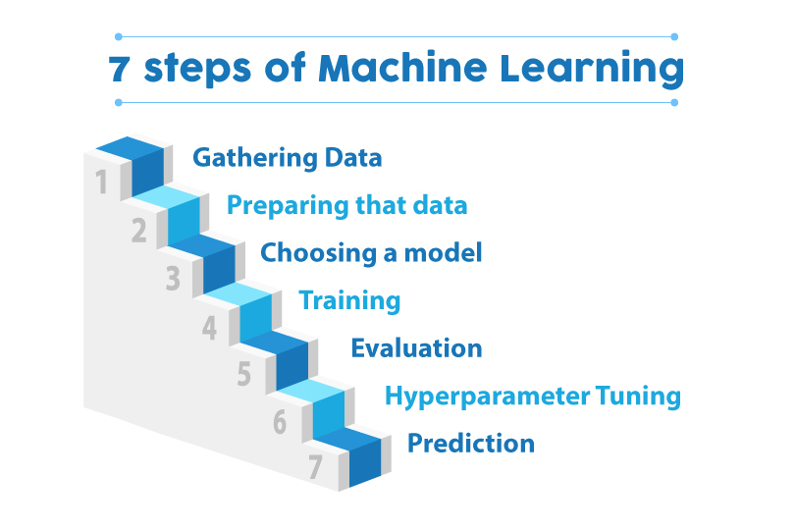
Machine learning is a field of computer science that gives computers the ability to learn without being programmed explicitly. The power of machine learning is that you can determine how to differentiate using models, rather than using human judgment.

Slide 10
1. Gathering Data:
Once you know exactly what you want and the equipment’s are in hand, it takes you to the first real step of machine learning- Gathering Data. This step is very crucial as the quality and quantity of data gathered will directly determine how good the predictive model will turn out to be. The data collected is then tabulated and called as Training Data.

Slide 11
2. Data Preparation or Data Preprocessing:
After the training data is gathered, you move on to the next step of machine learning: Data preparation, where the data is loaded into a suitable place and then prepared for use in machine learning training. Here, the data is first put all together and then the order is randomized as the order of data should not affect what is learned.
a. Data Visualization: It will help you see if there are any relevant relationships between the different variables, how you can take their advantage and as well as show you if there are any data imbalances present.
b. Data Split: The data has to be split into two parts. The first part that is used in training our model, will be the majority of the dataset and the second will be used for the evaluation of the trained model’s performance.

Slide 12
c. Data adjustments :
Missing or incomplete records. It is difficult to get every data point for every record in a dataset. Missing data sometimes appears as empty cells, values (e.g., NULL or N/A), or a particular character, such as a question mark. For example:
Outliers or anomalies. Unexpected values often surface in a distribution of values, especially when working with data from unknown sources which lack poor data validation controls.
Inconsistent values and non-standardized categorical variables. Often when combining data from multiple sources, we can end up with variations in variables like company names or states. For instance, a state in one system could be “Texas,” while in another it could be “TX.” Finding all variations and correctly standardizing will greatly improve the model accuracy.

Slide 13
Limited or sparse features / attributes. Feature enrichment, or building out the features in our data often requires us to combine datasets from diverse sources. Joining files from different systems is often hampered when there are no easy or exact columns to match the datasets. This then requires the ability to perform fuzzy matching, which could also be based on combining multiple columns to achieve the match.
For instance, combining two datasets on CUSTOMER ID (present in both data datasets) could be easy. Combining a dataset that has separate columns for CUSTOMER FIRST NAME and CUSTOMER LAST NAME with another dataset with a column CUSTOMER FULL NAME, containing “Last name, First name” becomes more tricky.
The need for techniques such as feature engineering. Even if all of the relevant data is available, the data preparation process may require techniques such as feature engineering to generate additional content that will result in more accurate, relevant models.

Slide 14
3. Choosing a model:
The next step that follows in the workflow is choosing a model among the many that researchers and data scientists have created over the years. Make the choice of the right one that should get the job done.
4. Training:
After the before steps are completed, you then move onto what is often considered the bulk of machine learning called training where the data is used to incrementally improve the model’s ability to predict.
The training process involves initializing some random values for say A and B of our model, predict the output with those values, then compare it with the model's prediction and then adjust the values so that they match the predictions that were made previously.
This process then repeats and each cycle of updating is called one training step.

Slide 15
5. Evaluation:
Once training is complete, you now check if it is good enough using this step. This is where that dataset you set aside earlier comes into play. Evaluation allows the testing of the model against data that has never been seen and used for training and is meant to be representative of how the model might perform when in the real world.
6. Parameter Tuning:
Once the evaluation is over, any further improvement in your training can be possible by tuning the parameters. There were a few parameters that were implicitly assumed when the training was done. Another parameter included is the learning rate that defines how far the line is shifted during each step, based on the information from the previous training step. These values all play a role in the accuracy of the training model, and how long the training will take.
7. Prediction:
Machine learning is basically using data to answer questions. So this is the final step where you get to answer few questions. This is the point where the value of machine learning is realized. Here you can Finally use your model to predict the outcome of what you want.
The above-mentioned steps take you from where you create a model to where you Predict its output and thus acts as a learning path.

Slide 16
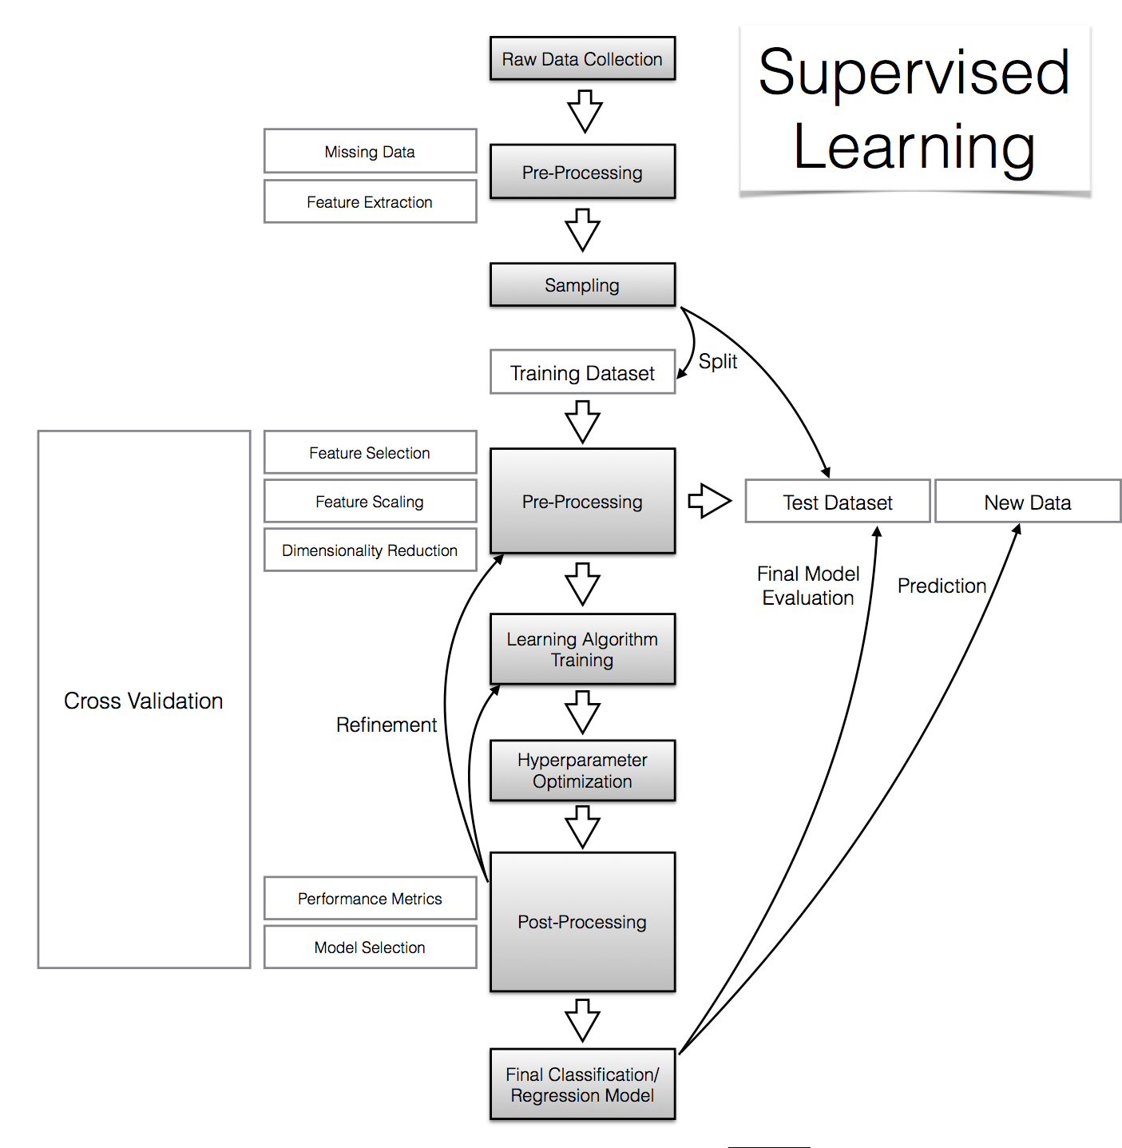

Slide 17
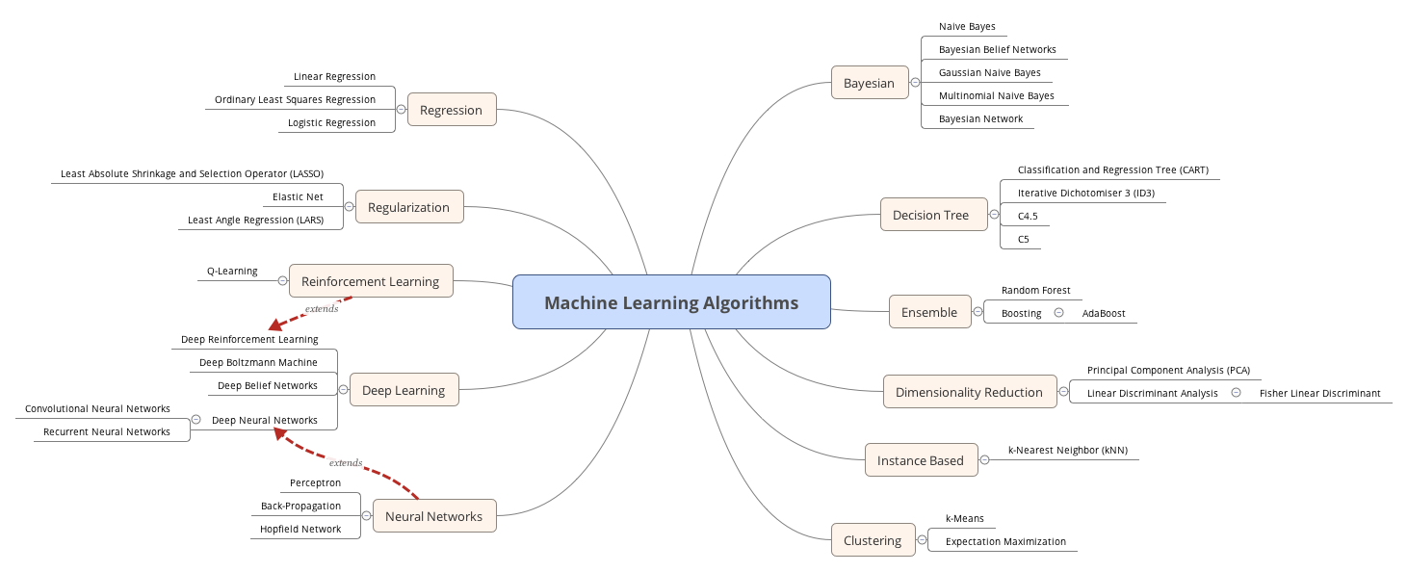

Slide 18
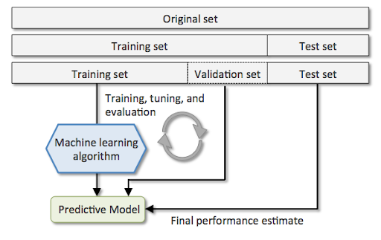

Slide 19
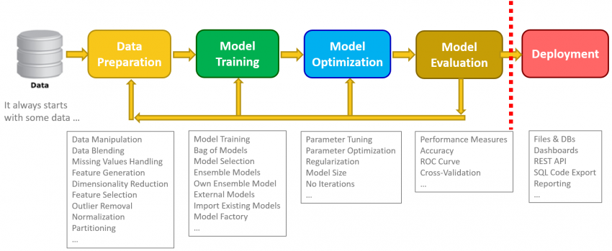

Slide 20
