Slide 1
Inferential Statistics
@DataScience

Slide 2
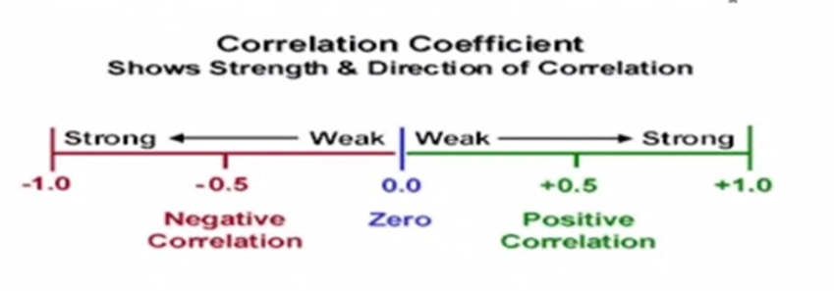
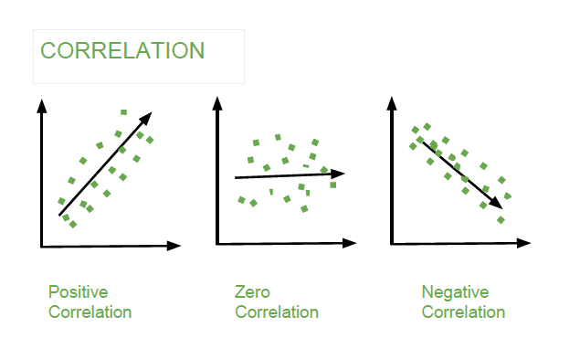

Slide 3
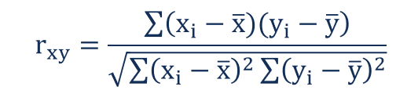
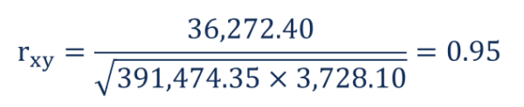
Where:
rxy – the correlation coefficient of the linear relationship between the variables x and y
xi – the values of the x-variable in a sample
x̅ – the mean of the values of the x-variable
yi – the values of the y-variable in a sample
ȳ – the mean of the values of the y-variable

Slide 4
import pandas as pd
import seaborn as sn
import matplotlib.pyplot as plt
data = {'A': [45,37,42,35,39],
'B': [38,31,26,28,33],
'C': [10,15,17,21,12] }
df = pd.DataFrame(data,columns=['A','B','C']) corrMatrix = df.corr()
print (corrMatrix)
sn.heatmap(corrMatrix, annot=True)
plt.show()

Slide 5
Correlation in Python
Correlation values range between -1 and 1.
There are two key components of a correlation value:
magnitude – The larger the magnitude (closer to 1 or -1), the stronger the correlation
sign – If negative, there is an inverse correlation. If positive, there is a regular correlation.

Slide 6
Inferential Statistics
Inferential statistics refers to methods that rely on probability theory and distributions.
Inferential statistics allows you to make inferences about the population from the sample data.
It uses a random sample of data taken from a population to describe and make inferences about the population.
Statistical inference is the process of using data analysis to draw conclusions of properties of an underlying probability distribution.

Slide 7
Random Experiment: A random experiment is a physical situation whose outcome cannot be predicted until it is observed.
Eg:- Tossing a coin, Throwing a dice, Observing a rain occur on a day or not etc.
Outcome : The result of a single trial of the random experiment
Eg:- Tossing a coin(head or tail), Throwing a dice(1or 2 or 3 or 4 or 5 or 6),Rain(Fall/Not)
Sample Space or Event: A sample space is a set of all possible outcomes of a random experiment.
Eg:- Tossing a coin.{H,T}
Tossing 2 coins.{HH,TH,HT,TT}
Throwing a dice(1 to 6)

Slide 8
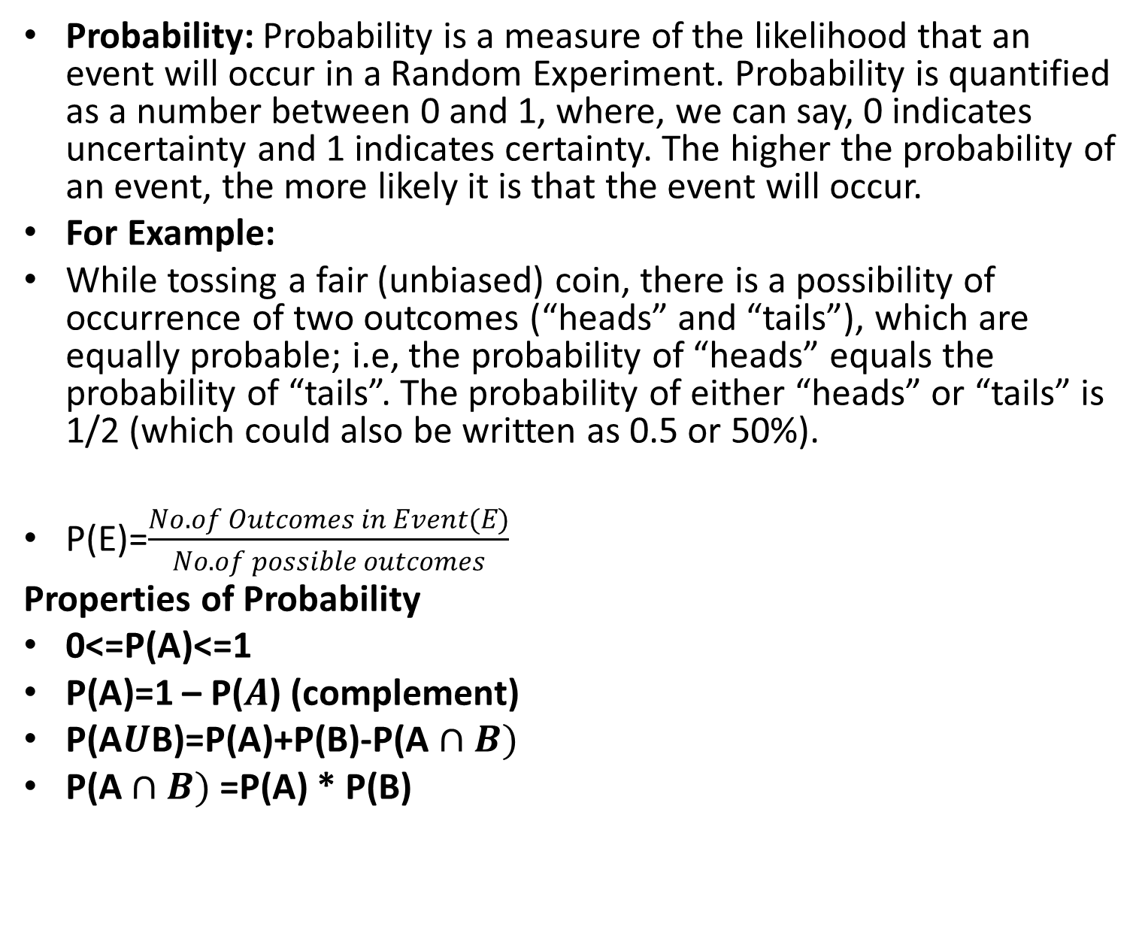
Probability: Probability is a measure of the likelihood that an event will occur in a Random Experiment. Probability is quantified as a number between 0 and 1, where, we can say, 0 indicates uncertainty and 1 indicates certainty. The higher the probability of an event, the more likely it is that the event will occur.
For Example:
While tossing a fair (unbiased) coin, there is a possibility of occurrence of two outcomes (“heads” and “tails”), which are equally probable; i.e, the probability of “heads” equals the probability of “tails”. The probability of either “heads” or “tails” is 1/2 (which could also be written as 0.5 or 50%).
P(E)=$\frac{No. of Outcomes in Event(E)}{No. of possible outcomes}$
Properties of Probability
0<=P(A)<=1
P(A)=1 – P($A$) (complement)
P(A$U$B)=P(A)+P(B)-P(A$∩B)$
P(A$∩B)$ =P(A) * P(B)

Slide 9

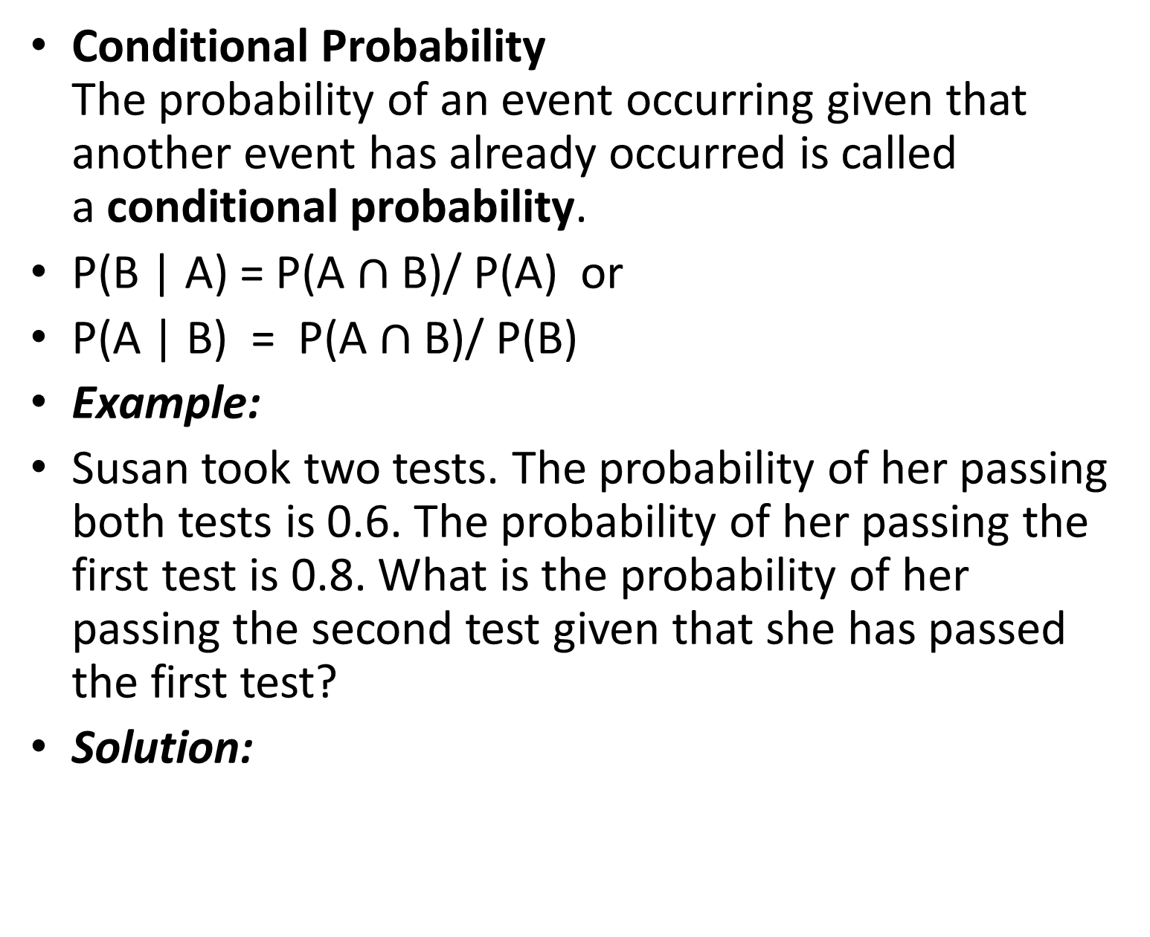
Conditional Probability
The probability of an event occurring given that another event has already occurred is called a conditional probability.
P(B | A) = P(A $∩$ B)/ P(A) or
P(A | B) = P(A $∩$ B)/ P(B)
Example:
Susan took two tests. The probability of her passing both tests is 0.6. The probability of her passing the first test is 0.8. What is the probability of her passing the second test given that she has passed the first test?
Solution:

Slide 10
Variable : It is a quantity whose value changes. It can also specify the characteristic of elements in the dataset. It can take any of the specific values
Discrete and Continuous Variables:
A discrete variable is a variable whose value is obtained by counting.(finite and infinite)
Examples: number of students present, number of red marbles in a jar, number of heads when flipping three coins, student’s grade level
A continuous variable is a variable whose value is obtained by measuring.
Examples: height of students in class, weight of students in class, time it takes to get to school, distance traveled between classes

Slide 11
When the value of a variable is the outcome of a statistical experiment, that variable is a random variable.
A random variable is a variable whose value is a numerical outcome of a random phenomenon.
▪ A random variable is denoted with a capital letter
▪ The probability distribution of a random variable X tells what the possible values of X are and how probabilities are assigned to those values
▪ A random variable can be discrete or continuous
Eg: Tossing 2 coins to get no. of heads {HH,TH,HT,TT}
<- A probability distribution is a table or an equation that links each outcome of a statistical experiment with its probability of occurrence
Generally, statisticians use a capital letter to represent a random variable and a lower-case letter, to represent one of its values. For example,
X represents the random variable X.
P(X) represents the probability of X.
P(X = x) refers to the probability that the random variable X is equal to a particular value, denoted by x.
As an example, P(X = 1) refers to the probability that the random variable X is equal to 1.
# of Heads (X) | Probability P(X)
0 | ¼=0.25
1 | 2/4 =1/2 =0.5
2 | ¼ = 0.25

Slide 12
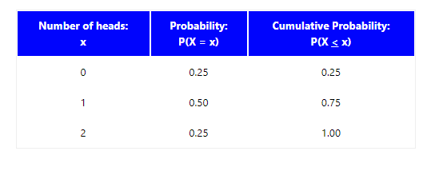
A cumulative probability refers to the probability that the value of a random variable falls within a specified range.
P(X <= 1) = P(X = 0) + P(X = 1)
= 0.25 + 0.50 = 0.75
P(X > 0) = P(X = 1) + P(X = 2)
= 0.50 + 0.25 = 0.75

Slide 13
Example 1
Suppose a die is tossed. What is the probability that the die will land on 5?
Solution: When a die is tossed, there are 6 possible outcomes represented by: S = { 1, 2, 3, 4, 5, 6 }. Each possible outcome is a random variable (X), and each outcome is equally likely to occur. Thus, we have a uniform distribution. Therefore, the P(X = 5) = 1/6.
Example 2
Suppose we repeat the dice tossing experiment described in Example 1. This time, we ask what is the probability that the die will land on a number that is smaller than 5?
Solution: When a die is tossed, there are 6 possible outcomes represented by: S = { 1, 2, 3, 4, 5, 6 }. Each possible outcome is equally likely to occur. Thus, we have a uniform distribution.
This problem involves a cumulative probability. The probability that the die will land on a number smaller than 5 is equal to:
P( X < 5 ) = P(X = 1) + P(X = 2) + P(X = 3) + P(X = 4)
P( X < 5 ) = 1/6 + 1/6 + 1/6 + 1/6 = 2/3

Slide 14
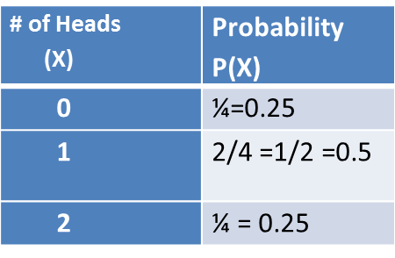
Discrete Probability Distributions
The probability distribution of a discrete random variable can always be represented by a table. For example, suppose you flip a coin two times. This simple exercise can have four possible outcomes: HH, HT, TH, and TT. Now, let the variable X represent the number of heads that result from the coin flips. The variable X can take on the values 0, 1, or 2; and X is a discrete random variable.
The table below shows the probabilities associated with each possible value of X. The probability of getting 0 heads is 0.25; 1 head, 0.50; and 2 heads, 0.25. Thus, the table is an example of a probability distribution for a discrete random variable.

Slide 15
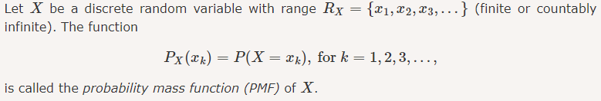
Probability Mass Function(PMF)

Slide 16
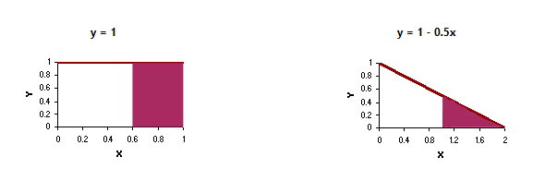
Continuous Probability Distributions
probability distribution of a continuous random variable is represented by an equation, called the probability density function (pdf).
All probability density functions satisfy the following conditions:
The random variable Y is a function of X; that is,
y = f(x).
The value of y is greater than or equal to zero for all values of x.
The total area under the curve of the function is equal to one.

Slide 17
PMF
1. Bernoulli
2. Binomial
3. Poisson
PDF
1. Uniform
2. Normal
3. Exponential

Slide 18
Bernoulli
A Bernoulli random variable is a random variable that can only take two possible values, usually 0 and 1.
This random variable models random experiments that have two possible outcomes, sometimes referred to as "success" and "failure." Here are some examples:
You take a pass-fail exam. You either pass (resulting in X=1) or fail (resulting in X=0).
You toss a coin. The outcome is either heads or tails.
A child is born. The gender is either male or female.

Slide 19
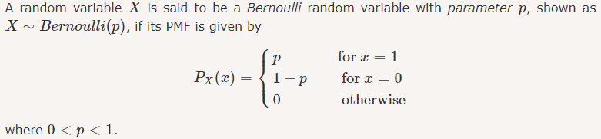

Slide 20
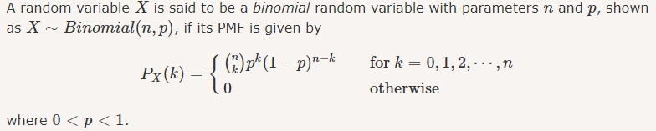
Binomial Distribution
Suppose that I have a coin with P(H)=p.
I toss the coin n times and define X to be the total number of heads that I observe.
Then X is binomial with parameter n and p, and we write X∼Binomial(n,p).
The range of X in this case is R_{X}={0,1,2,...,n}

Slide 21
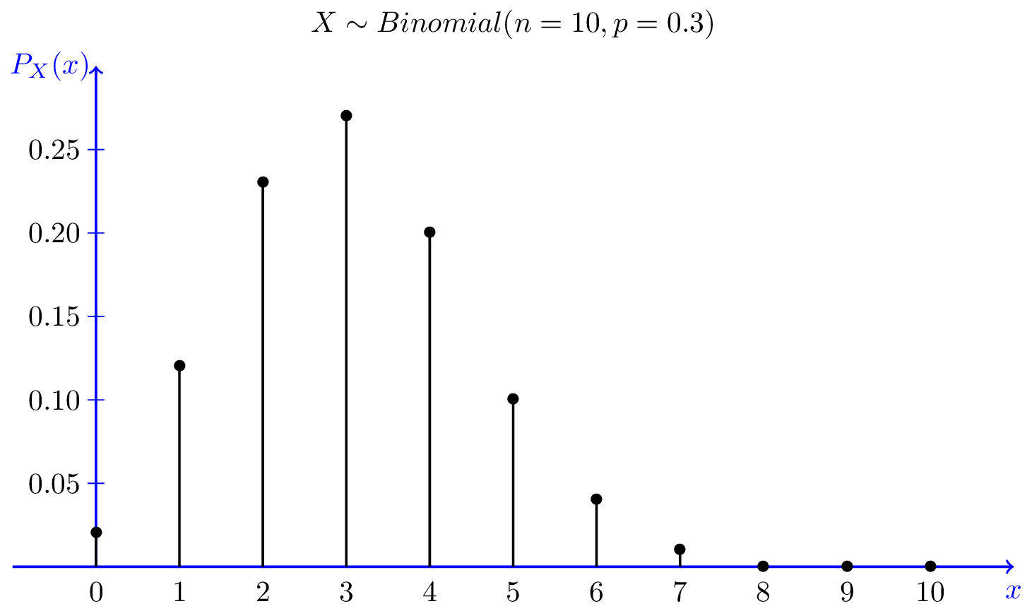
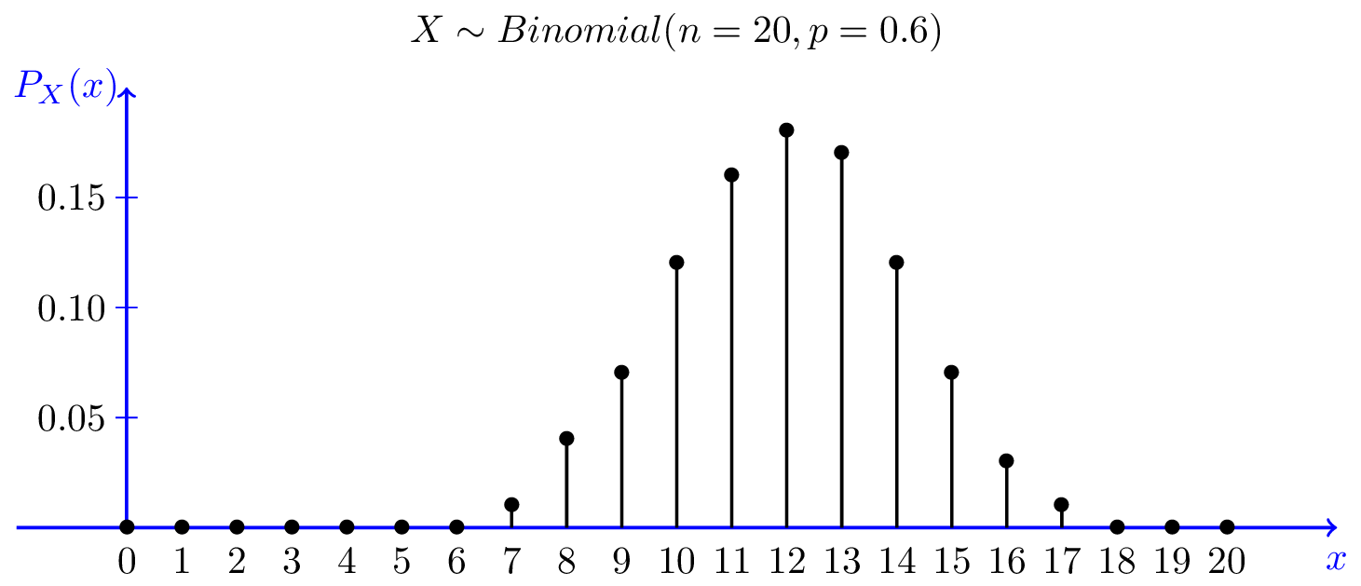
Binomial(n,p)
n=10, p=0.3 and n=20, p=0.6

Slide 22
Poisson Distribution
The Poisson distribution is one of the most widely used probability distributions.
It is usually used in scenarios where we are counting the occurrences of certain events in an interval of time or space.
In practice, it is often an approximation of a real-life random variable.
Suppose that we are counting the number of customers who visit a certain store from 1pm to 2pm.
Based on data from previous days, we know that on average λ=15 customers visit the store.
Of course, there will be more customers some days and fewer on others.
Here, we may model the random variable X showing the number customers as a Poisson random variable with parameter λ=15.

Slide 23
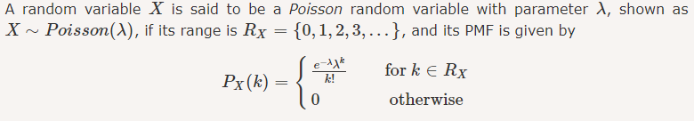

Slide 24
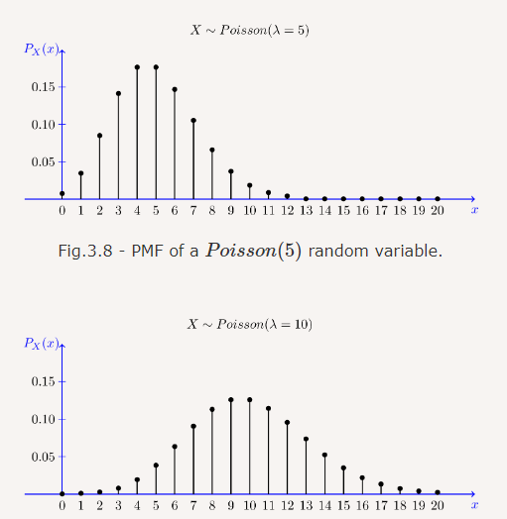

Slide 25
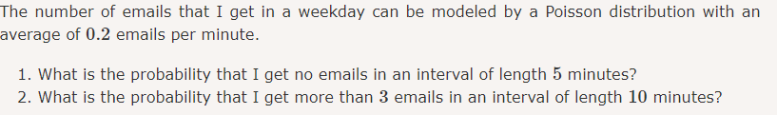

Slide 26
Probability Density Function
@Statistics
#Data Science

Slide 27
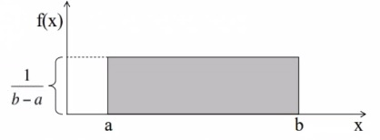
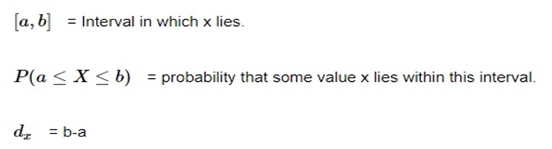
Uniform Distribution
A uniform distribution is a distribution that has a constant probability.
EXAMPLE: If we roll a die(numbered from 1 to 6), then the probability of getting 1 is one out of six i.e., 1/6. Similarly, the probability of getting 2, 3, 4, 5 and 6 also is ⅙. There is an equal chance of getting each of the 6 outcomes. Now, if we check for the probability of getting 7, then it is 0 since it is impossible to get a 0 when rolling a die.

Slide 28
Normal Distribution
The Normal Distribution is a very common continuous probability distribution.
This type of distributions are important in statistics and are often used to represent random variables whose distribution is not known.
The statistical term for this type of distribution is Gaussian Distribution though many people call it Bell curve as it is shaped like one.
This type of distribution is symmetric and its mean, median and mode are equal.
Mathematically, Gaussian Distribution is represented as:N~(μ, σ² )
Where N stands for Normal, symbol ~ stands for distribution, symbol μ stands for mean and σ² stands for variance.

Slide 29
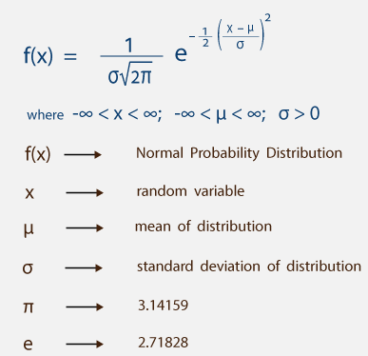
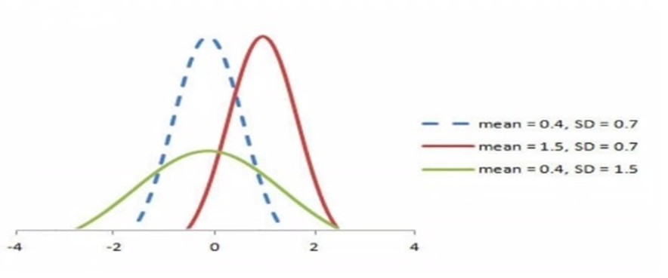
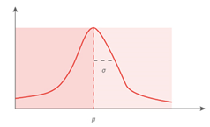

Slide 30
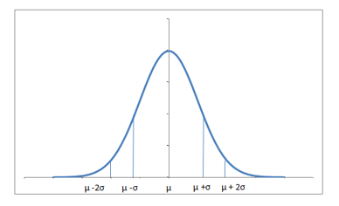
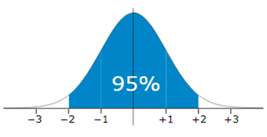
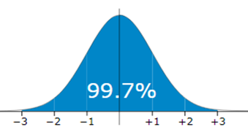
Almost 68% of the data falls within a distance of one standard deviation from the mean on either side and 95% within two standard deviations. Also it worth mentioning that a distribution with mean 0 and standard deviation 1 is called a standard normal distribution.

Slide 31
Every distribution can be standardized. Let say if the mean and the variance of a variable are μ and σ² respectively.
Standardization is the process of transforming a variable to one with a mean of 0 and a standard deviation of 1. i.e., N~(μ, σ² ) → ~ N(0, 1)
Where x is data element, μ is mean and σ is the standard deviation
We use the letter Z to denote standardization.
The standardized value i.e., Z is known as the z-score.
These Z scores are important because they tell you how far a value is from the mean. When you standardize a random variable, its ‘mean’ becomes 0 and its standard deviation becomes 1.
If the Z score of x is zero, then the value of x is equal to the mean.

Slide 32

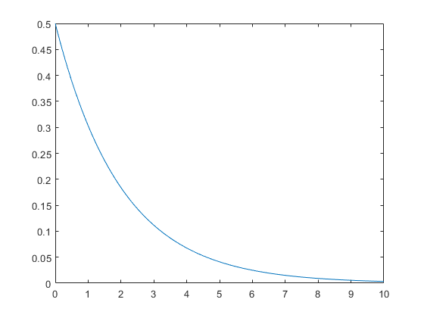
Exponential Distribution
The exponential distribution describes the time between events in a Poisson point process, i.e., a process in which events occur continuously and independently at a constant average rate. It has a parameter λ called rate parameter, and its equation is described as :

