Slide 1
STATISTICS

Slide 3
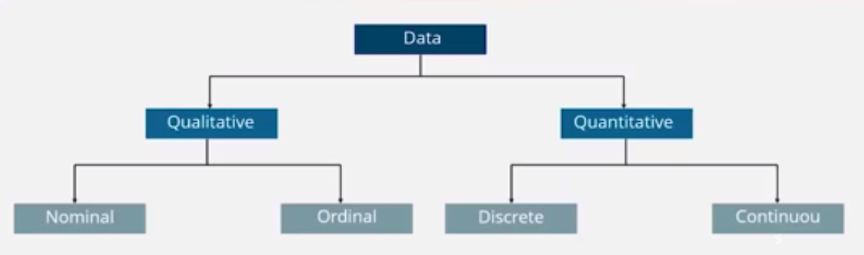
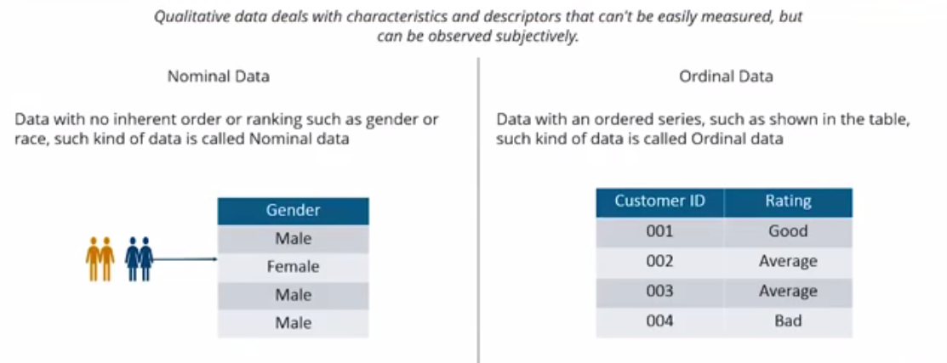

Slide 4
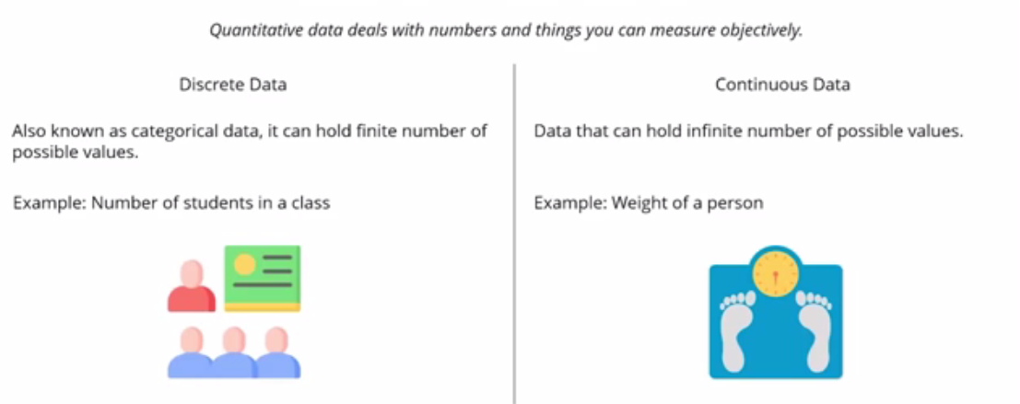
Raw data: Values collected and recorded with little or no checking, calculation or interpretation.
Population: A group we are interested in studying. “Population” often refers to a group of people, but the term is used for other subjects, too.
Sample: The subset of a population used to collect data.
Record: In a dataset, a collection of information about a single person or other subject.
Variable: Characteristic about each element of population or sample
Parameter: A numerical value summarizing entire population data
Statistic: A numerical value summarizing entire sample data

Slide 5
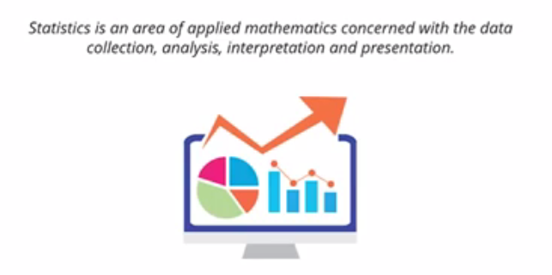



Slide 6
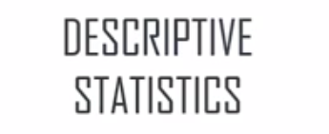
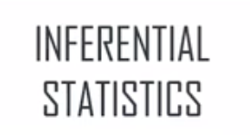
TYPES OF STATISTICS

Slide 7
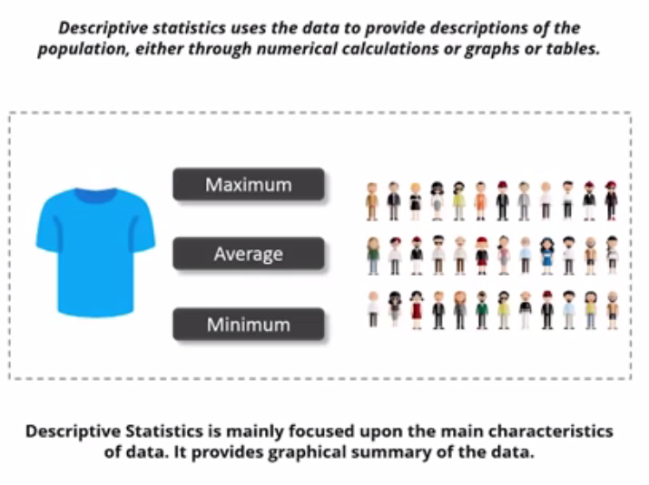

Slide 8
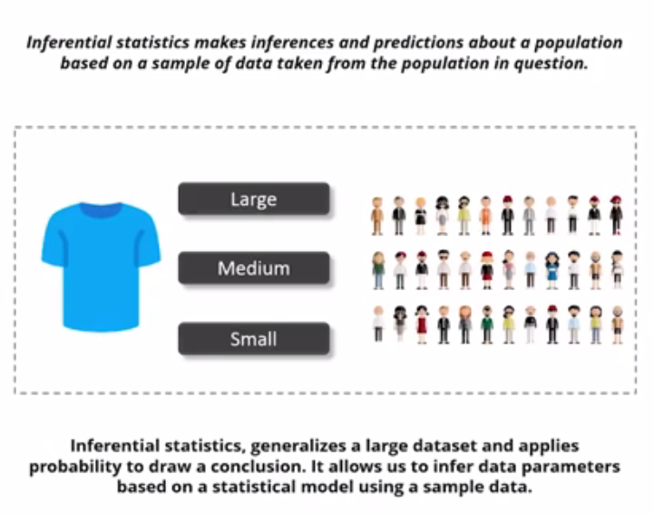

Slide 9
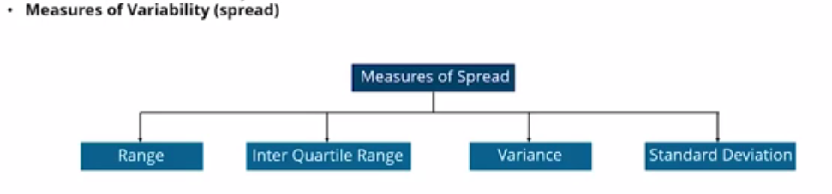

Slide 10
• central tendency: Do the values tend to cluster around a particular point?
• modes: Is there more than one cluster?
• spread: How much variability is there in the values?
• tails: How quickly do the probabilities drop off as we move away from the modes?
• outliers: Are there extreme values far from the modes?
outliers, which are extreme values that might be errors in measurement and recording, or might be accurate reports of rare events.

